Slide 1

SwissIX Update #10
SWINOG#22 – 9. Mai 2011
Marco Huggenberger
Notes:
Hi Everybody! My Name is Marco Huggenberger, President of the SwissIX Association
I‘ll give you the SwissIX Update Number 10.

Slide 2
Update #10
Historic questions
Update from the GM
Statistics
Outlook
Notes:
I would like to give you a short update on what‘s happening at our exchange point.
In the following 10 minutes I will ask you some historic questions and talk about the latest news
from our general meeting, some statistics and a short outlook about our activities.

Slide 3

History
When & where was the idea about SwissIX presented for the first time?
Why can we present our updates here at SwiNOG?
What does the SwissIX Update #10 really means for us?
Notes:
To check if you‘re really listening to my presentation, we start with a difficult question about our organisation:
ANSWER1: This was 11 years ago in 2000 at SwiNOG#1! Basically Wouter van Hulten from Interxion presented the initial proposal to create a Swiss Internet Exchange association.
So, let‘s go to our second question to see if you‘re still listening to my presentation:
ANSWER2: Well that‘s an easy one to answer: It‘s simply because the guys behind SwiNOG, I‘m talking about the SwiNOG core-team organise SwiNOG events very well.
Of course they also invite us to share our updates, growth and success with the SwiNOG Community
And therefore I would like to thank them firstly for their work and secondly to bring the Swiss Network Operators Community always a little bit closer together – even it is on a Monday morning like today ;)
ANSWER3: Well, some of you already know, it‘s the 10th birthday of our associations – or in other words we run our exchange now over 10 years! So let‘s celebrate this a little bit later at the social event today ;)

Slide 4
Update from the GM
New „Articles of the association“
The board has now a 2 years mandate
The yearly fee applies now also for participants, which made them almost equal to members
SwissIX Annual Report:
http://www.swissix.ch/public/2010/
Notes:
On our latest general meeting which was held on 9th of march this year
We‘ve presented „new articles of the association“ which included for example a 2 years mandate (instead of 1 year) for the board.
Additionally we‘ve also voted that the participants (without voting rights) will be handled the same like members who already payed a membership fee.
Last not but least, we published our Second annual report which is now also available on our website (sorry guys it‘s only in german)
All of these changes where accepted by the majority of the members and are already in force.

Slide 5
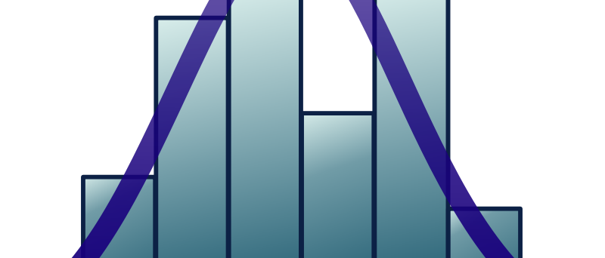
Facts & Figures
.
Participants: +20 within the last 12 months
Ports: From FastE to 10GigE
Available maximum capacity +200 Gbps
A maximum of 25 Gbps Peak Traffic (May 2011)
Notes:
Since Mai 2011 we connect over 130 participants (that‘s a plus of around 20 compared to last year)
Looking at our nearly 150 Ports, we see connection speeds from 55 FastEthernet, 78 GigabitEthernet and 15 10GigabitEthernet, which
Gives us an available maximum capacity of over 200 Gbps on our peering network
In Mai we‘ve also reached a peak traffic level above 25 Gbps, which is 20 Gbps more traffic than just a year before

Slide 6
Facts & Figures
..
Locations: 8 Sites
Hardware: Brocade only
Routing with SwissIX RouteServers
Interconnection: Upgraded capacity
Notes:
Locations: Still 8 Sites, major changes where introduced at Equinix, where we‘ve migrated the existing participants to their latest facility.
Hardware: Since September 2010 we have a „brocade only network“. At Interxion we had such a massive growth, that we needed to upgrade our Brocade modular Chassis from 8 to 16 Slots
If you use our RouteServers, then you can currently learn around 10K IPv4 Prefixes and 350 IPV6 Prefixes.
Looking at our Interconnection: We had a massive growth of intersite traffic between Interxion and Equinix, and we‘v improved that situation by placing a flexibel DWDM system which carries now 2 times 10GigE between the sites.

Slide 7
Facts & Figures
...
Notes:
Here‘s our public graph of the total aggregated traffic on our network.
Seen enough? Let‘s finish this up with a short outlook on our acitivties....

Slide 8
Outlook
Growth and continuity in operations
Continue to develope the Association
Negotiate and maintain contracts
Notes:
Besides of growth and continuity in operations we‘re looking forward to adopt for (hopefully) the next 10 years
Continue to develope the association which is delivering Services to it‘s customers but also keep an eye on
Negotiate and maintain contracts: With existing and of course also new sponsors or partners

Slide 9
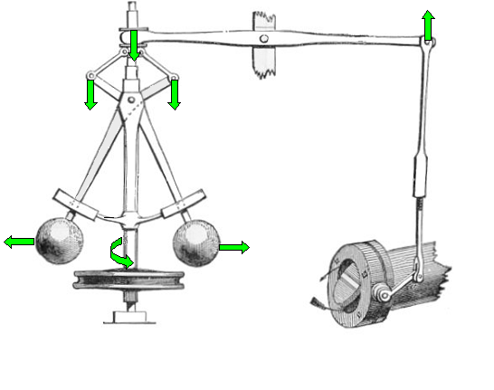
Feedback
Contact: marco.huggenberger@swissix.ch
Thank you for your attention!
Notes:
Finally we‘re at the end: Any questions, or feedback?
Feel free to contact me anytime soon by e-mail.
Thanks for your attention ;)

